Slide 1


Traffic Signs Recognition
Team - 16
Under the Guidance of
Guide Name: D. Kavya Shruthi
Designation: Assistant Professor
Team:
16WH1A1226 - J. Nicole
16WH1A1234 - K. Lakshmi Prasanna
16WH1A1258 - T. Soumya

Slide 2
Content
Introduction
Problem Definition
Literature Survey
Existing System and Proposed System
Architecture Diagram
TSR Output
Conclusion
Action Plan
References

Slide 3
Introduction
Traffic signs are an essential part of our day to day lives.
It contains critical information that ensures the safety of all the people around us.
Without traffic signs, all the drivers would be clueless about what might be ahead to them and roads can become a mess.
On the other hand, researchers and big companies are working extensively on proposing solutions to self-driving cars.
These automatic cars need to follow the traffic rules and for that, they have to understand the message conveyed through traffic signs.

Slide 4
Problem Definition
> In this Project, we will build a deep neural network model that can classify traffic signs present in the image into different categories. With this model, we are able to read and understand traffic signs which is a very important task for all autonomous vehicles.

Slide 5
Literature Survey
Author Name | Technology | Implementation
Tam T. Le | SVM method | Method to retrieve candidate region of traffic sign.
Hassan Shojania | Thresholding and Convolution masks | Method used Geometric constraint, but not implemented pictographic recognition.
Auranuch Lorsakul | Neural Network Technique | Technique detects only the circle shape in the test sign images and distortion images.

Slide 6
Existing and Proposed System
Existing System: The system Tam T. Le proposed method concerns blocks of pixels, so it helps to handle diversification of data. It could be always flawless if an updated traffic sign location DB would be available. But few cars have GPS installed and traffic sign localization DB are not available.
Proposed System: The earlier Computer Vision techniques required lots of hard work in data processing and it took a lot of time to manually extract the features of the image. Now, deep learning techniques have come to the rescue for recognition of traffic signs in autonomous vehicles.

Slide 7
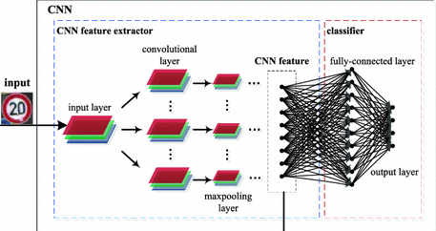
Architecture Diagram

Slide 8
Feature Map

Slide 9
Dataset
Category | Task | Number of images
Training data | Uset to train the network | 34799
Validation data | Allows to supervise the network performances while training it | 4410
Testing data | Uset to evaluate the final network | 12630
Train.csv & Test.csv columns - width, height, classId, path.
Meta.csv columns - Path, ImageId, ShapeId, ColorId, SignId.

Slide 10
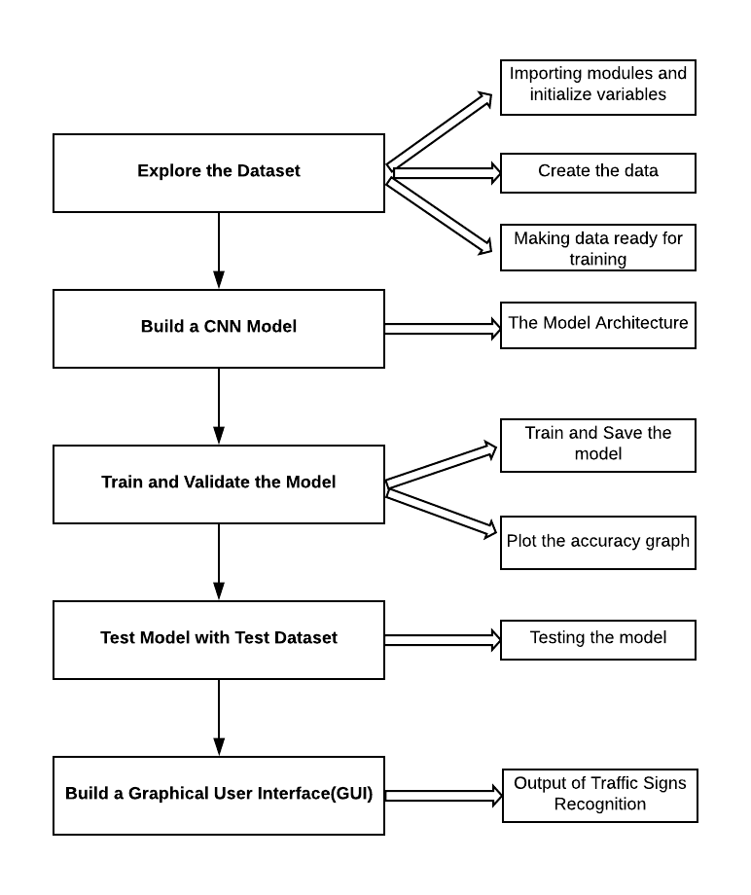
Implementation

Slide 11
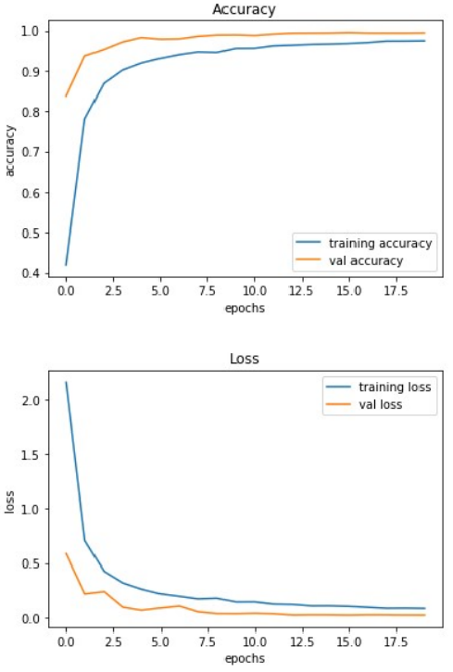
Accuracy and Loss graphs

Slide 12
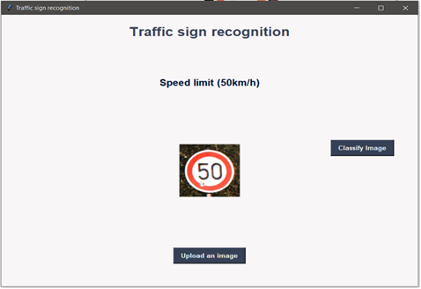
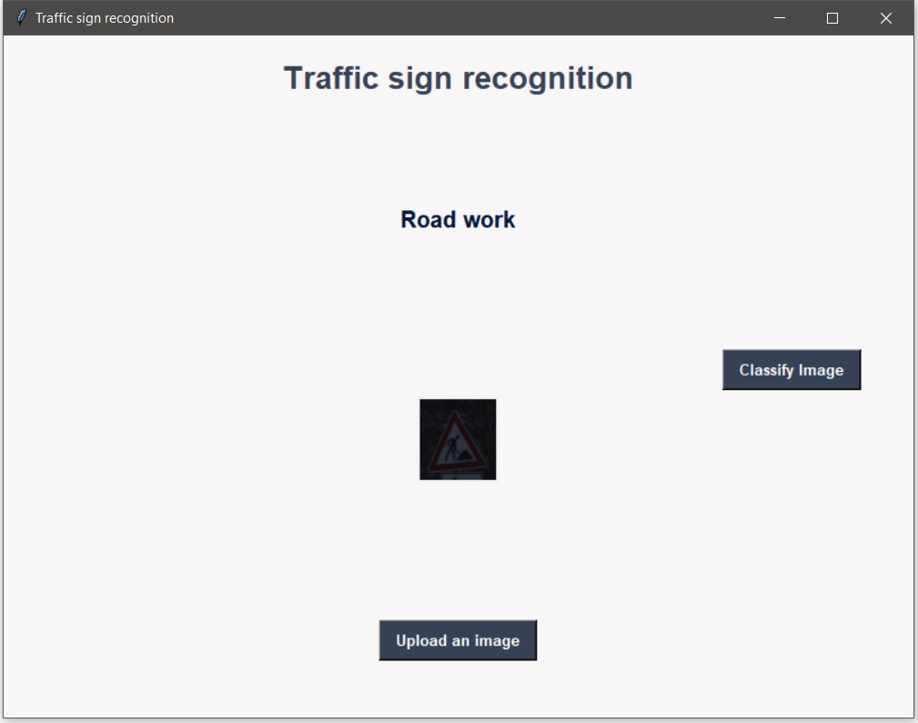
TSR Output
Output

Slide 13
Conclusion
This system provides approach for detecting road traffic signs with quality output. It includes efficient feature extraction methods which results in appropriate outcomes. The CNN model is the finest techniques of Deep Learning for Image Classification.
The model we have used gives the test accuracy of 98%. This algorithm has a best speculation, and it can be trusted that it is used to identify more conventional traffic signs.

Slide 14
Action Plan
Module Information | Status | Time required to Complete
Literature Survey | Completed | 1 Week
Requirement Analysis | Completed | 1 Week
Design | Completed | 2 Weeks
Implementation | Completed | 4 Weeks
Documentation | Completed | 2 Weeks

Slide 15
References
https://ieeexplore.ieee.org/document/8652024
https://pdfs.semanticscholar.org/5fd7/eca5432e4e4038dfc2ad425fa5f3e87
https://ieeexplore.ieee.org/abstract/document/7338642
https://www.kaggle.com/meowmeowmeowmeowmeow/gtsrb-german-traffic- sign#Test.csv (Kaggle - Dataset(TSR))

Slide 16


